Slide 1


Slide 2
1 in 100
Notes:
In 2008, for the first time, 1 in 100 Americans was in jail or prison.

Slide 3
500,000
Notes:
The number of Americans in jail or prison in 1980.

Slide 4
2,400,000
Notes:
The number of Americans in jail or prison in 2015.

Slide 5
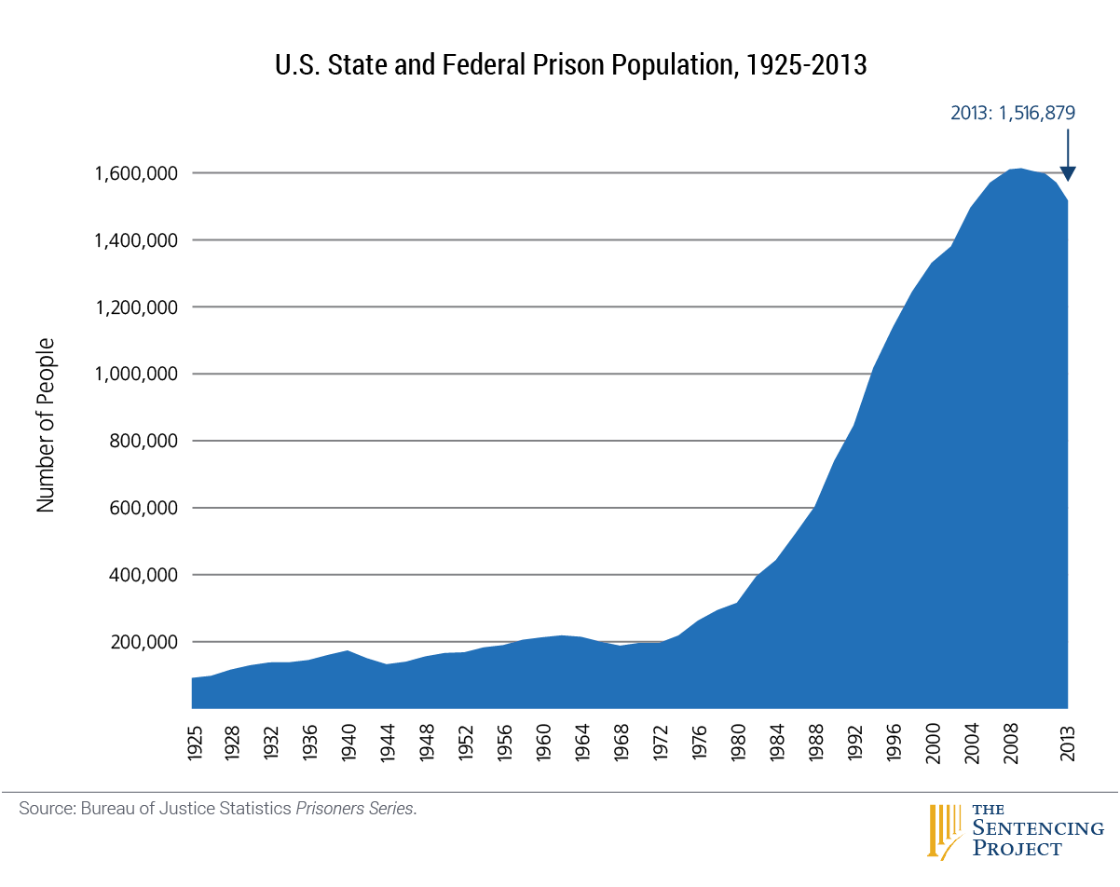

Slide 6
55
Notes:
Number of Japanese in jail or prison per 100,000

Slide 7
114
Notes:
Number of Canadians in jail or prison per 100,000

Slide 8
730
Notes:
Number of Americans in jail or prison per 100,000

Slide 9
1 in 31
Notes:
Americans under some sort of control of correctional system.

Slide 10
1 in 18
Notes:
American men under some sort of control of correctional system.

Slide 11
1 in 11
Notes:
Black Americans under some sort of control of correctional system.

Slide 12
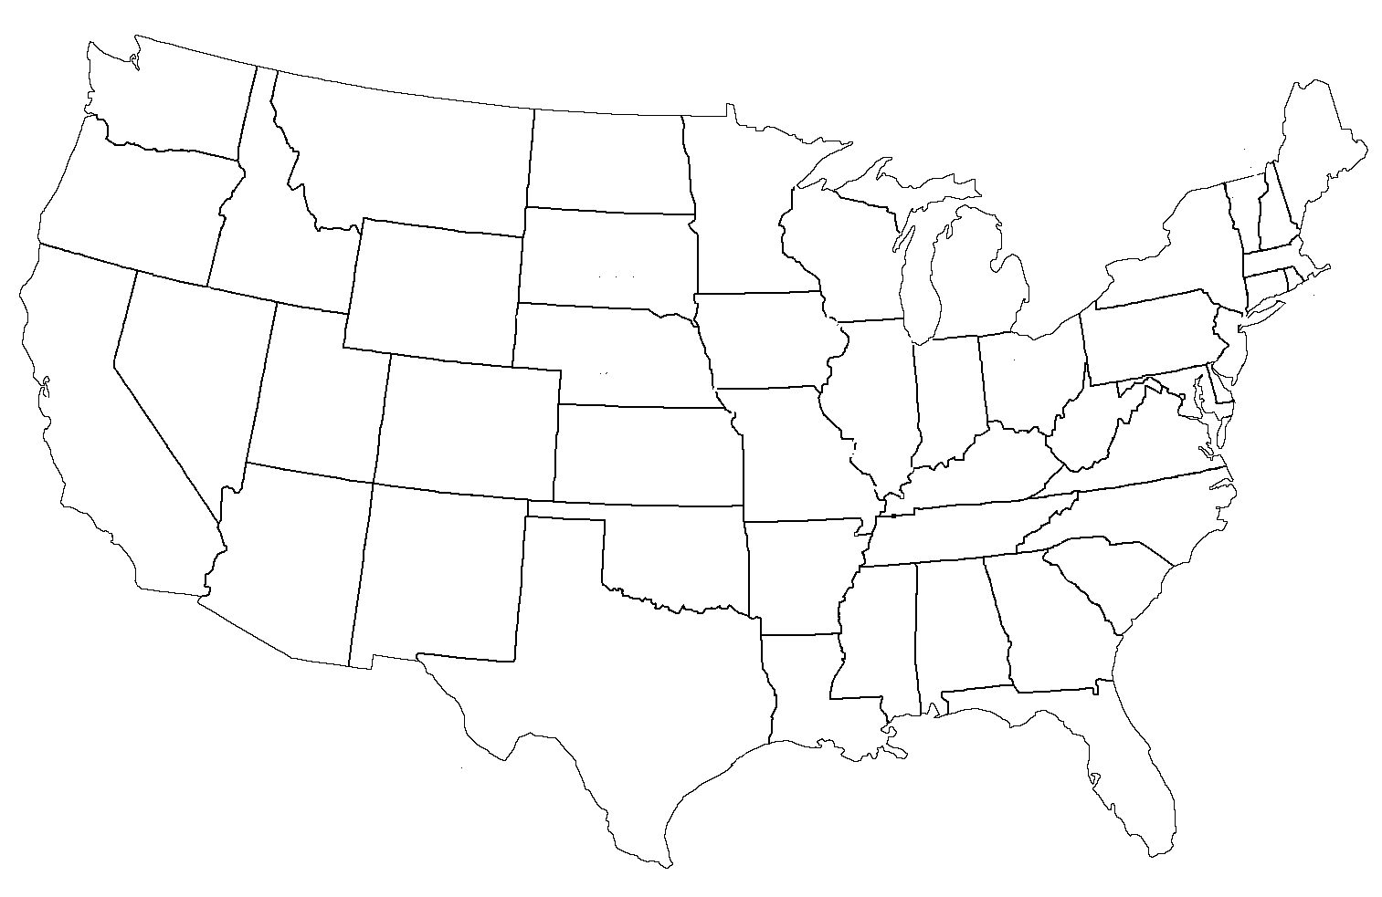
Race in the United States

Slide 13
13%
Notes:
Black as percentage of US population, Bureau of Justice Statistics

Slide 14
38%
Notes:
Black as percentage of US prison population, 2011, Bureau of Justice Statistics

Slide 15
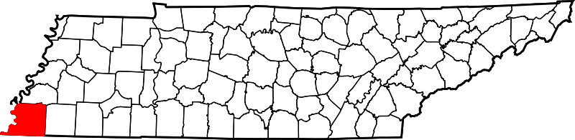
Race in the Shelby County

Slide 16
53%
Notes:
Black as percentage of Shelby County population, 2013, US Census

Slide 17
87%
Notes:
Black as percentage of Shelby County Jail population 2014

Slide 18
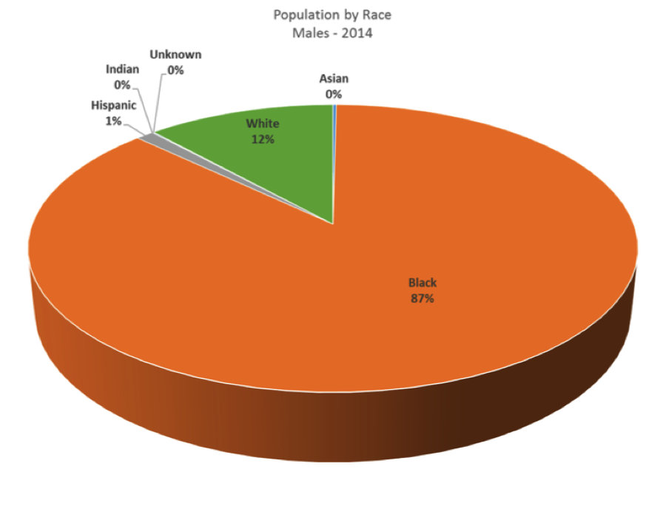
Shelby County Jail Population by Race

Slide 19
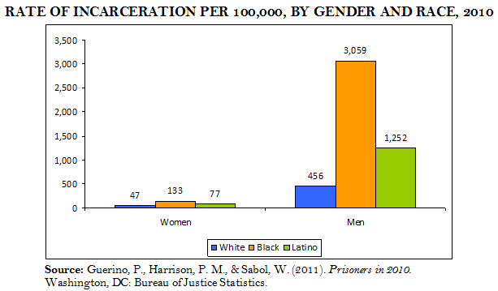

Slide 20
65 million
Notes:
Black as percentage of Shelby County Jail population 2014

Slide 21
What’s at Stake?
Loss of employment
Loss of property
Loss of public housing
Loss of food stamp eligibility
Loss of financial aid for college
Loss of the right to vote
. . . even AFTER serving time in prison
Notes:
80% of mid-size to large companies check criminal backgrounds of applicants per 2006 survey by the Society for Human Resource Management

Slide 22
What can be expunged in Tennessee?
Dismissed/Nolle Prosequi/Not Guilty
Completed Diversion
Certain convictions - 2012 amendment
THAT’S ALL

Slide 23
Diversion
  First-time offender
  Excluded: DUI, sexual offenses, Class A or B felonies
  This is NOT a retroactive designation.
  Diversion ALWAYS includes a period of supervision after a conditional guilty plea.
  $450 fee must be paid after all other costs.

Slide 24
Convictions - 2012 Amendment
  First-time offender; certain E felonies and A misdemeanors
  T.C.A. 40-32-101(g) designates offenses
  No convictions elsewhere
  Five (5) years since completion of sentence
  This IS a retroactive designation.
  $450 fee after all other costs paid

Slide 25
Expungement in Shelby County
Criminal Court Clerk – 4th Floor, 201 Poplar
  (901) 222-3200
  TBD, expungement clerk
  Request file, pay any fees, fill out Expungement Order, present to court
General Sessions Criminal Court Clerk – LL81, 201 Poplar
  (901) 222-3600
  Phyllis Williams, expungement clerk
  Unlike Criminal Court, GS Criminal will generate order and present to court for approval without an attorney’s involvement (exception: GS13)

Slide 26
Just City – Clean Slate Fund

Slide 27
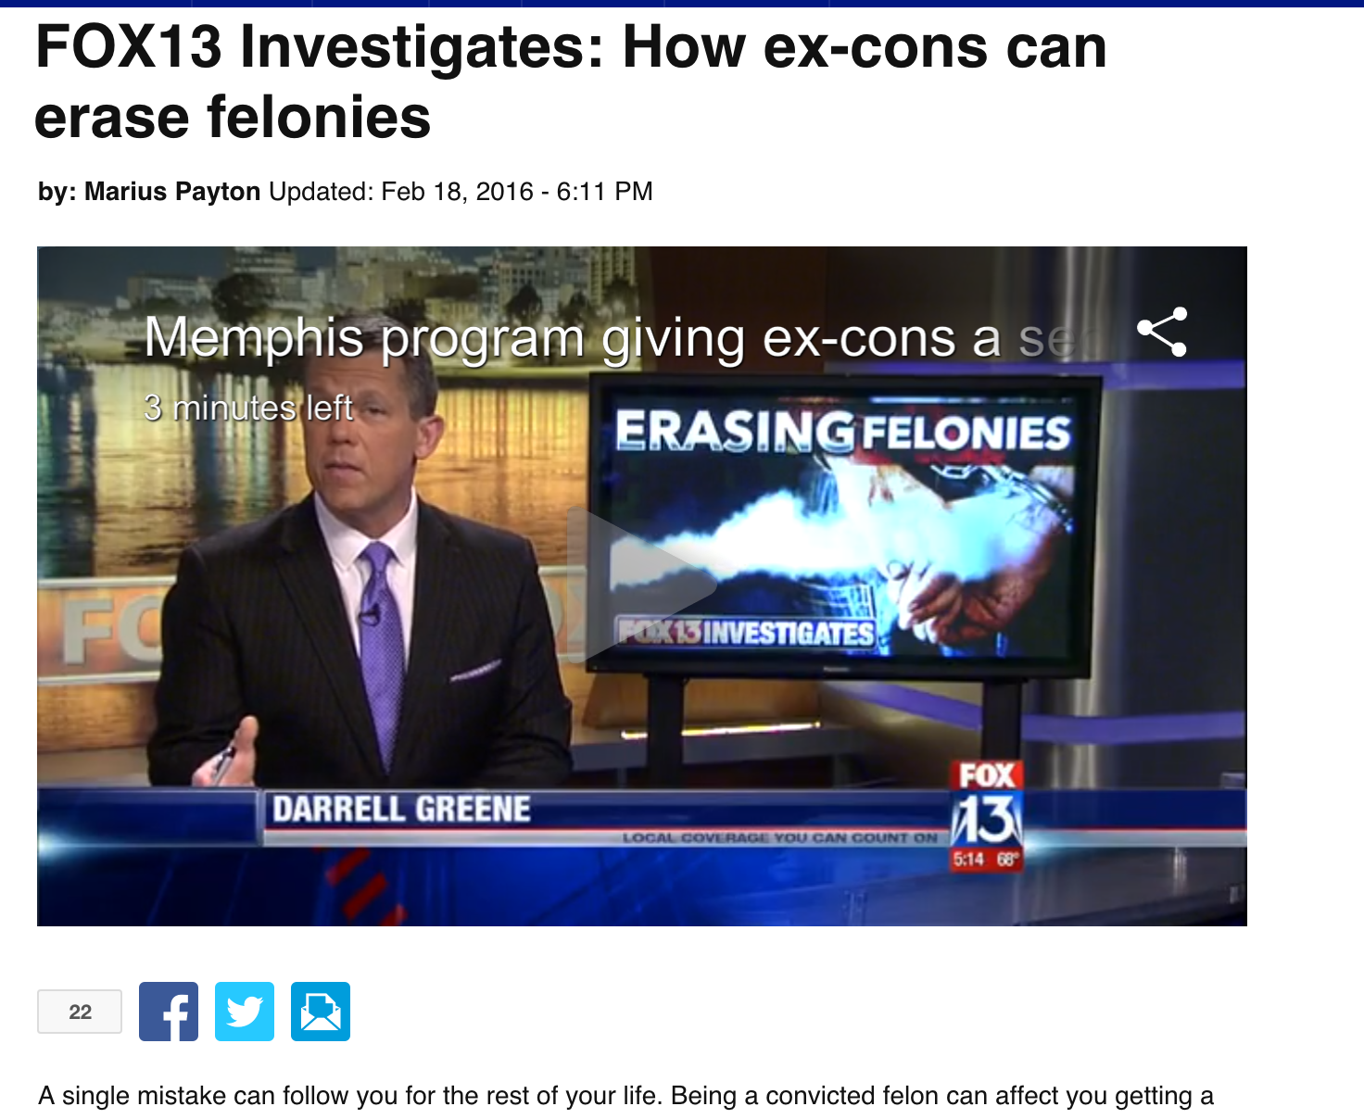
Just City – Clean Slate Fund

Slide 28
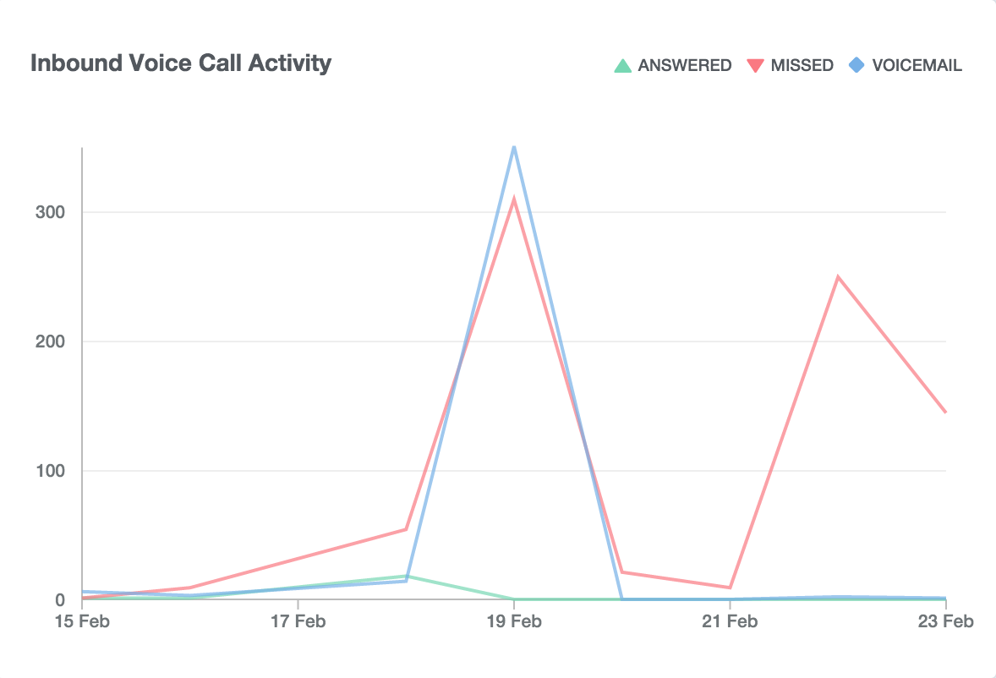
Just City – Clean Slate Fund

Slide 29

JustCity.org

Slide 30
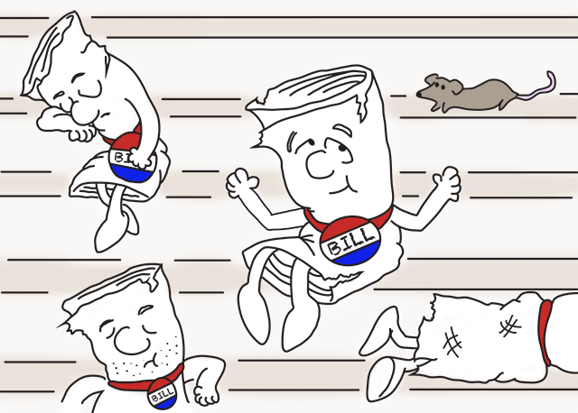
Expungement Bills Pending

Slide 31





Info@JustCity.org
@JustCity901
facebook.com/JustCity901
JustCity.org

